Slide 1
Introduction Data Structure
1. What is Data structure ?
2. Why we need to study Data structure ?
3. Major components that define Data Structure
4. Classification of data structures

Slide 2
Formal Definition :
In computer science, a Data structure is defined to be a well structured format that is used to Organize, Manage, and Store data in a memory at the time of processing.

Slide 3
Basic Need for Data Structure
Many Computer programs serves some kind of Data processing during computation.
    To access these data and to collect the resulting data, it is necessary to organize them in some reasonable structure in a well defined format. This well defined format structure is being facilitated by a term Data structure
    This reasonable format is also going to increase the efficiency in organizing, managing, and storing the data in a memory at the time of processing

Slide 4
Basic Need of Data Structure
  II. As many application programs are being built and are becoming more complex, even the amount of data is also increasing day by day, which may cause many problems with respect to processing speed, searching data and handling multiple requests etc.
    To address and resolve these problems Data structure plays an important role in enhancing the performance of a program with respect to storing and retrieving the data.

Slide 5
III. Knowing data structures, it is easier to learn many different programming languages.

Slide 6
Basic Need of Data Structure
  iV. Data structure and Algorithms play a vital role in the field of computer science.
  Data structures allow us to organize and store data, while algorithms allow us to process that data in a meaningful way.
    Learning Data structure and Algorithms will help you become a better programmer. You will be able to write code that is more efficient and more reliable.
    You will also be able to solve problems more quickly and more effective

Slide 7
Three major components that define Data Structure
Relationships: In a data structure, elements are related or connected in some way. They follow a sequence, or are arranged in a certain format. This contrasts with an assortment of different but unrelated variables. For example, three stand-alone integers do not necessarily share any relationship.
Operations: Each data structure is associated with a collection of functions that can implement and manipulate it. These integrated algorithms are used to interact with the actual data. Most data structures support operations such as adding or deleting an item. However, other operations are only meaningful in certain situations. For instance, it might make sense to sort an array, but not a hash table.
Data Values and Type: The definition of a data structure also includes the values it contains and the type of data it allows. In some data structures, all values must have the same type, while others do not enforce any restrictions.

Slide 8
Classification of data Structure
Primitive Data Structure –
  Primitive Data Structures directly operate according to the machine instructions.
  Data types like int, char, float, double, and pointer are primitive data structures that can hold a single value.
Non – Primitive Data Structure –
  Non-primitive data structures are complex data structures that are derived from primitive data structures.
  Non – Primitive data types are further divided into two categories.
    Linear Data Structure - Examples are List, Queue, Stack, Array etc.
    Non – Linear Data Structure - Examples are Tree, BST, Graphs etc.

Slide 9
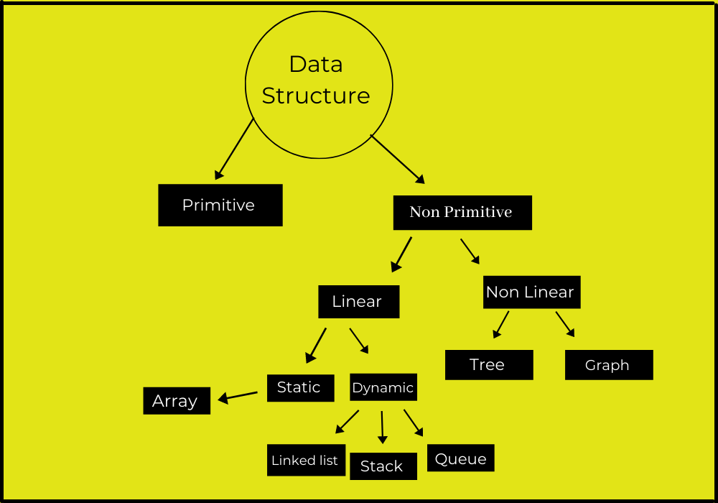

Slide 10
Topics to be covered :
UNIT-1. Pointers and Structures
1. Pointers, Structures : Introduction to pointers, pointers and Arrays, Pointers to pointers, pointers to functions
2. Introductions to Structures : Declarations, initializations, Accessing Structures, Internal implementations of structures
3. Files in C : Text input output with respect to files in C, Basic file handling functions in C

Slide 11
Pointers
Objectives
  To understand the concept and use of pointers
  To be able to declare, define, and initialize pointers
  To write programs that access data through pointers
  To use pointers as parameters and return types
  Topics to be covered
    1. Introduction to pointers
    2. Pointers and Arrays
    3. Pointers to pointers
    4. Pointers to functions

Slide 12
1. Introduction to Pointers
Defination : A pointer is a variable that contains an address of other variable in a memory during exection.
Advantages :
Pointers can be used to return multiple values from a function via function arguments (output parameters).
Pointers allow C to support dynamic memory management.
Use of pointers increases the execution speed and thus reduces the program execution time.

Slide 13
Example - Returning MULTIPLE values from a functions

Slide 14
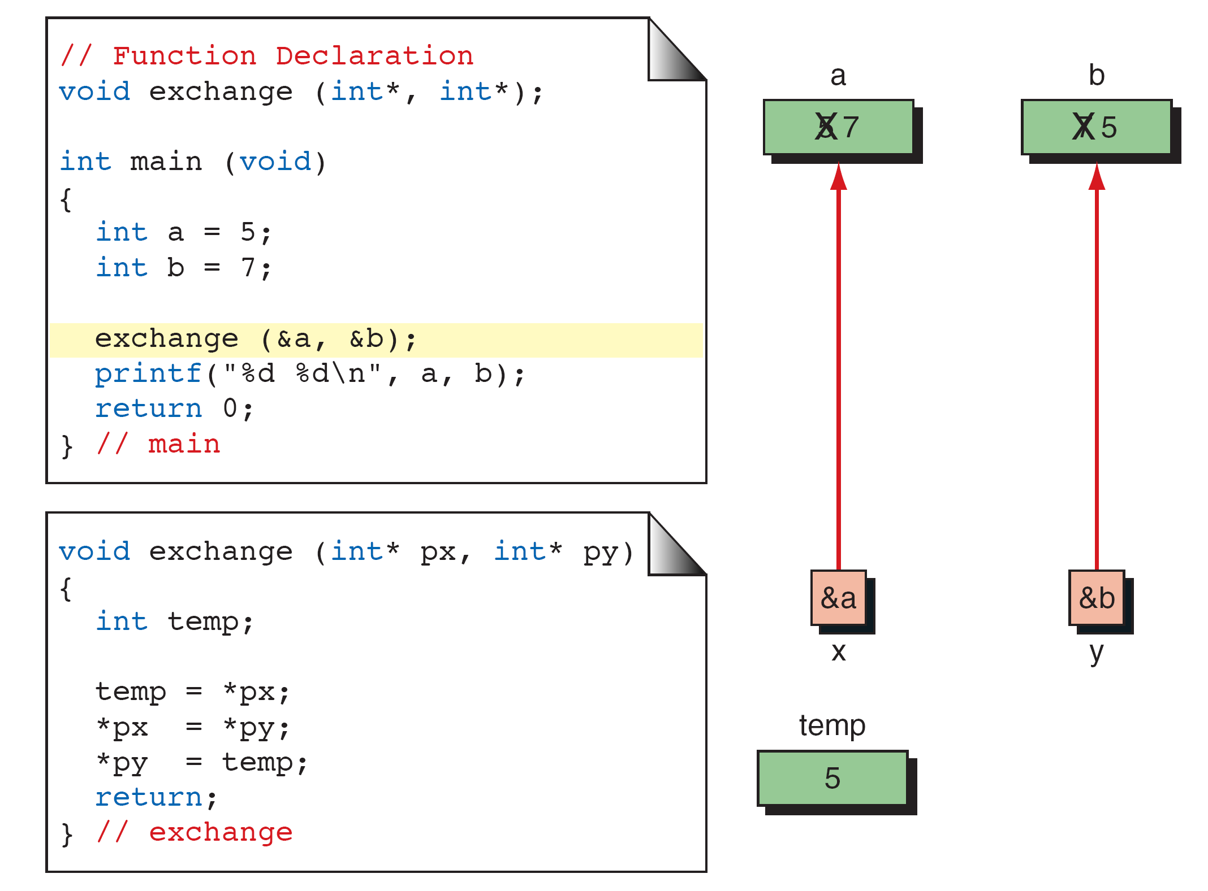
Example - Returning MULTIPLE values from a functions

Slide 15
Understanding Pointers
0
Computer’s memory is a sequential collection of storage locations.
Each location, commonly known as a byte, is identified by an address associated with it.
These addresses are numbered consecutively, starting from zero.
The last address depends on the memory size.
A computer system having 64K memory has its last address as 65535.
1
2
3
4
5
.
.
.
.
65535

Slide 16
Example on Accessing the Address of a Variable
We can access the address of a variable with the & operator in C.
  We have already used & operator in scanf function.
The operator & immediately preceding the variable returns the address of the variable associated with it.
  p = &quantity; //assigns the address 5000 (value decided at run time) to p.
The & operator can be used only with a simple variable or an array element.

Slide 17
int quantity = 250;
A variable that can hold address of another variable is called a pointer variable.
quantity
variable
250
value
5000
address

Slide 18
int quantity = 250;
int *p = &quantity;
Since the value of the variable p is the address of the variable quantity, we may access the value of quantity by using the variable p, and therefore we say that the variable p points to the variable quantity. Thus p is the name of the pointer.
variable
value
address
quantity
250
5000
p
5000
5012

Slide 19
main()
{
int a;
float p, q;
char choice;
a = 15;
p = 10.25;
q = 5.46;
choice = 'Y';
printf("%d is stored at address %p\n", a, &a);
printf("%f is stored at address %p\n", p, &p);
printf("%f is stored at address %p\n", q, &q);
printf("%c is stored at address %p\n", choice, &choice);
}
Output:
15 is stored at address 6356748
10.250000 is stored at address 6356744
5.460000 is stored at address 6356740
Y is stored at address 6356739

Slide 20
Declaring Pointer Variables
Declaration Syantax : data_type *ptr_name;
  The asterix (*) tells that the variable ptr_name is a pointer variable.
  ptr_name needs a memory location.
  ptr_name points to a variable of type data_type.
Examples - 1. int *p; // declares the variable p as a pointer variable that can point to a memory location holding an integer data type.
2. float *q; // declares the variable q as a pointer variable that can point to a memory location holding float data type.
Since the memory locations corresponding to p and q have not been assigned any values, these contain garbage value and therefore point to unknown locations.
  Example: int *p;
p
?
?
contains garbage
points to unknown location

Slide 21
Initialization of Pointer Variable
The process of assigning the address of a variable to a pointer variable is known as initialization.
  Uninitialized pointers will have unknown values.
  It is important to initialize pointer variables before they are used in the program.
    int quantity;
    int *p;
    p = &quantity;
int *p = &quantity;

Slide 22
Initialization of Pointer Variable
We must ensure that the pointer variables always point to the corresponding type of data.
  float a, b;
  int sum, *p;
  p = &a; // Wrong
It is possible to combine declaration of simple variable, declaration and initialization pointer variable in one statement.
  int a, *p = &a;
  Declares a as an integer variable and p as a pointer variable and then initializes p hold the address of a.
We can also define a pointer variable with an initial value of NULL or zero.
  int *p = NULL; // same as int *p = 0;

Slide 23
Accessing a Variable Through its Pointer
To access value of a variable using the pointer, we use the asterisk (*) operator, also known as the indirection operator or dereferencing operator.
  int quantity, *p, n;
  quantity = 250;
  p = &quantity;
  n = *p; // equivalent to n = *&quantity; which in turn // is equivalent to n = quantity;
  Here *p returns the value of the variable quantity.

Slide 24
main()
{
int a, b;
int *p;
a = 15;
p = &a;
b = *p;
printf("Value of a is %d and address is %u\n", a, &a);
printf("Value of a is %d and address is %u\n", *&a, &a);
printf("Value of a is %d and address is %u\n", *p, p);
printf("%d is the address pointed to by %u\n", p, &p);
printf("Value of b is %d and address is %u\n", b, &b);
*p = 25;
printf("Now the value of a is %d", a);
}
Value of a is 15 and address is 6356748
Value of a is 15 and address is 6356748
Value of a is 15 and address is 6356748
6356748 is the address pointed to by 6356740
Value of b is 15 and address is 6356744
Now the value of a is 25

Slide 25
Stage
Values stored in locations and their addresses
a
b
p
Declaration
int a, b;
int *p;
6356748
6356744
6356740
a
b
p
a = 10
10
6356748
6356744
6356740
a
b
p
p = &a
10
6356748
6356748
6356744
6356740
a
b
p
b = *p
10
10
6356748
6356748
6356744
6356740

Slide 26
ADD few more Examples

Slide 27
Pointers and Arrays
When an array is declared, the compiler allocates a base address and memory to hold the array elements in contiguous memory locations.
  The base address is the location of the first element (index 0) of the array.
  The compiler also defines the array name as a pointer to the first element.
  int a[5] = {4, 10, 8, 5, 20};
  The name a is the base address (pointer) that points to the first element, a[0] and therefore value of a is 1000.
Elements
a[0]
a[1]
a[2]
a[3]
a[4]
Value
4
10
8
5
20
Address
1000
1004
1008
1012
1016
base address

Slide 28
int *p;
p = a; // equivalent to p = &a[0];
  p is an integer pointer that points to array a.
  We can access elements of a using p.
  p = &a[0] (=1000)
  p+1 = &a[1] (=1004)
  p+2 = &a[2] (=1008)
  p+3 = &a[3] (=1012)
  p+4 = &a[4] (=1016)
Address of a[3] = base address + (3 * sizeof(int))
= 1000 + (3 * 4) = 1012

Slide 29
Program to add array elements using Pointers
main()
{
int a[] = {3, 4, 8, 2, 7, 5};
int *p, i, sum;
p = a;
sum = 0;
for(i=0; i<6; i++)
{
sum = sum + *p;
p++;
}
printf("Sum is %d", sum);
}

Slide 30
Pointers to pointers
So far, all our pointers have been pointing directly to data.
It is possible—and with advanced data structures often necessary—to use pointers that point to other pointers.
For example, we can have a pointer pointing to a pointer to an integer

Slide 31
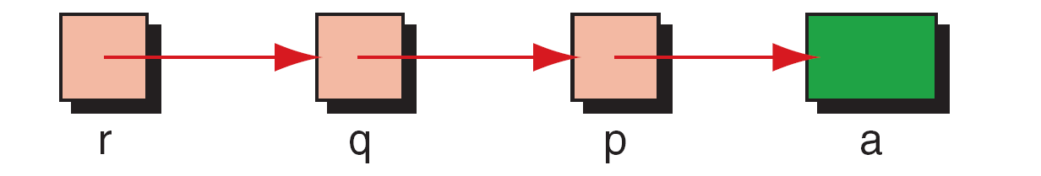
FIGURE 9-21 Using Pointers to Pointers
Computer Science: A Structured Programming Approach Using C

Slide 32
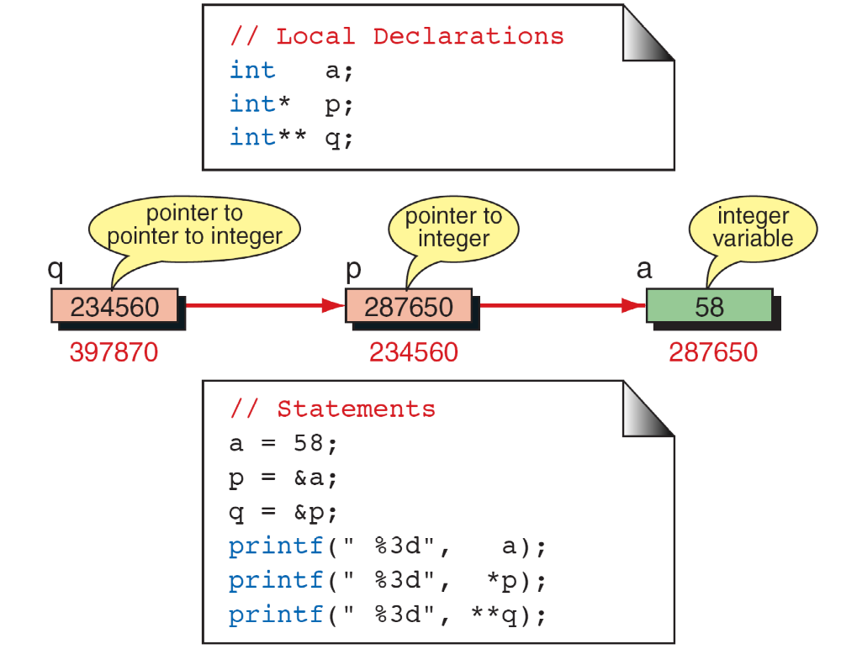
FIGURE 9-20 Pointers to Pointers
Computer Science: A Structured Programming Approach Using C

Slide 33
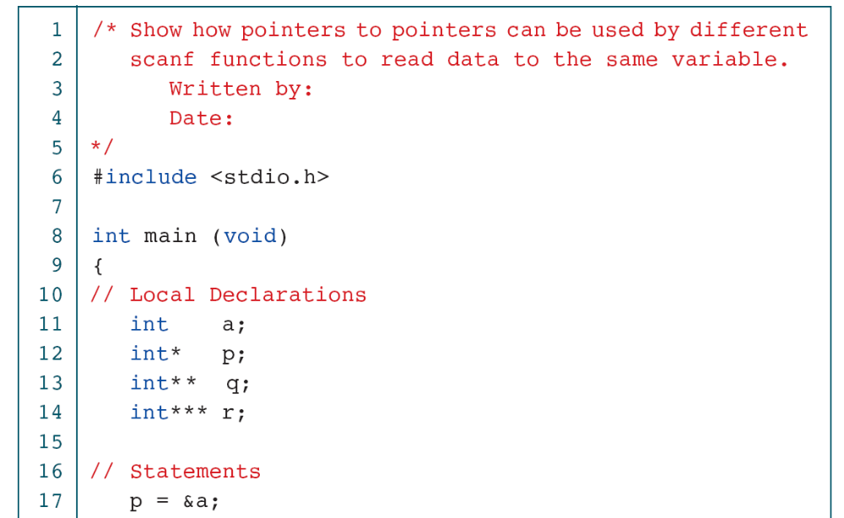
PROGRAM 9-6
Using pointers to pointers
Computer Science: A Structured Programming Approach Using C

Slide 34
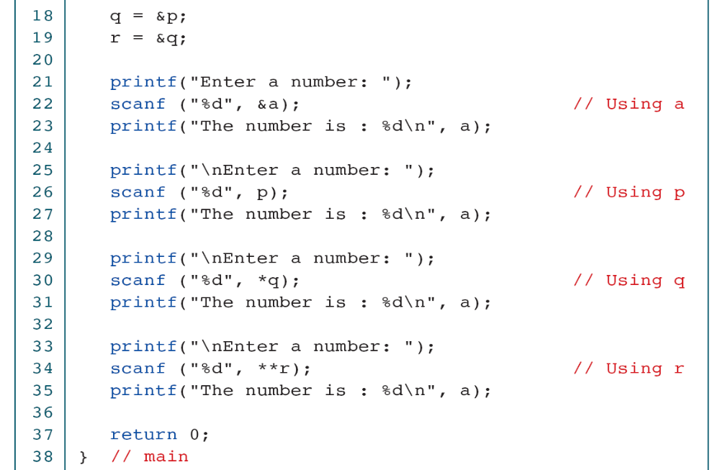
PROGRAM 9-6
Using pointers to pointers
Computer Science: A Structured Programming Approach Using C

Slide 35
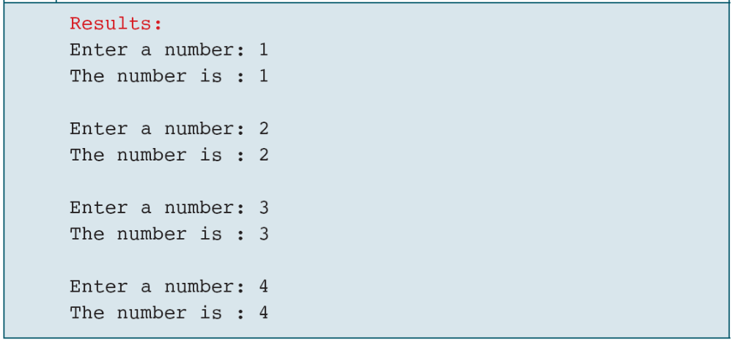
PROGRAM 9-6
Using pointers to pointers
Computer Science: A Structured Programming Approach Using C

Slide 36
Pointers to functions

Slide 37
Pointer to Function
Functions in our program occupy memory. The name of the function is a pointer constant to its first byte of memory.
To declare a pointer to function, we code it as if it was a prototype definition, with the function pointer in parentheses.
Syntax –
return_type (* ptr_name) (arg1_type, arg2_type2....);

Slide 38
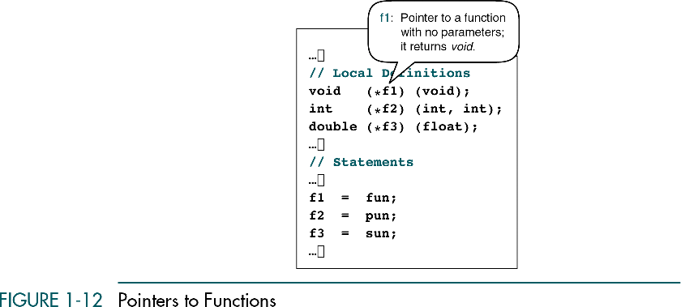

Slide 39
#include <stdio.h>
void show(int x)
{
printf("Value of x is %d\n", x);
}
int main()
{
void (*p)(int); // declaring a pointer
p = show; // p is the pointer to the show()
(*p)(7); //initializing values.
return 0;
}

Slide 40
2. Structures :
1. Introduction
2. Declarations, initializations,
2. Accessing Structures,
3.Internal implementations of structures

Slide 41
2. Structures - Introduction
Arrays can be used to represent a group of data elements of same type.
However, we cannot use an array to represent a collection of data elements of different types using a single name.
C supports a constructed (or programmer-defined) data type called structures, a mechanism for grouping data of different types.
  A structure can be used to group logically related data items.

Slide 42
Arrays Vs. Structures
An array is a collection of related data elements of same type.
  Structure can have elements of different types.
An array is a derived data type whereas a structure is a programmer-defined type.
An array behaves like a built-in type. We just declare an array and use it.
  In case of structure, we need to define the format of the structure before the variables of that type are declared and used.

Slide 43
Structures help us to organize complex data in a meaningful way…
Examples on related data items
  book
    author, title, price, year
  student
    name, roll-no, marks
  address
    name, door_number, street, city, pin
  customer
    name, phone_no, city
  inventory
    item, stock, price

Slide 44
Defining a Structure
Example
  struct Book
  {
    char title[20];
    char author[15];
    int pages;
    float price;
  };
Syntax
  struct structure_name
  {
    data_type member1; data_type member2;
    …
    data_type member;
  };
The keyword struct defines a structure with a name Book to hold four data fields viz., title, author, pages and price.
  These fields are called structure elements or members.
  Each member may belong to a different data type.
  Book is the name of the structure and is called the structure tag.
  The tag name can be used subsequently to declare variables.

Slide 45
Defining a Structure
The keyword struct defines a structure to hold four data fields viz., title, author, pages and price.
  These fields are called structure elements or members.
  Each member may belong to a different data type.
  Book is the name of the structure and is called the structure name or structure tag.
  The tag name can be used subsequently to declare variables.

Slide 46
Defining a Structure
array of 20 characters
title
array of 15 characters
author
integer
pages
price
float
Note that the definition does not declare any variables. It simply describes a format called template to represent the information as shown above.

Slide 47
Declaring Structure Variables
  Syntax:
    struct <tag_name> variable_list;
  Example:
    struct Book C-Book, DS-book[5], Maths-books[10];
  Remember that the members of a structure themselves are not variables.
  They do not occupy any memory until they are associated with the structure variables such as C-book.

Slide 48

The following declaration is also valid.
  struct Book
  {
    char title[20];
    char author[15]
    int pages;
    float price;
  } C-book, DS-book[5], Maths-books[10];
The use of tag_name is optional here.
  However, this is not recommended, as we cannot use it for future declarations.

Slide 49
Accessing Structure Members
Structure members have no meaning individually without the structure variable.
In order to assign a value to any structure member, the member name must be linked with the structure variable using a dot ● operator also called period or member access operator.
  strcpy(C-book ● title, “Programming in C”);
  strcpy(C-book ● author, “Balaguruswamy”);
  C-book ● pages = 250
  C-book ● price = 175.50;

Slide 50
We can also use scanf to assign values to the members.
struct Book
{
char title[25];
char author[10];
int pages;
float price;
};
main()
{
struct Book c-book;
printf("Enter title. Author, pages and price of a C book :");
scanf("%s%s%d%f", c-book.title, c-book.author);
scanf(“%d%f”, c.book.pages, c.book.price);
printf(“ C Book details are...\n");
printf(“ Title of the book :%s\n”, c-book.title);
printf(“ Author of the book : %s\n ”,c-book.author
printf(“ Pages in the book : %d\n ”,c-book.pages:
printf(“ Price of the book : %f “, c-book.price);
}

Slide 51
Structure Initialization
C does not permit the initialization of individual structure members within the template.
The initialization must be done only in the declaration of the actual variables.
Like any other data type, a structure variable can be initialized at compile time.
Syntax:
  struct <tag_name> structure-var = {initialization_list};
Example:
  struct Book C-book= {“C-Programming”,“Ritche", 225, 250.0 };

Slide 52
Rules for Initializing Structures
We cannot initialize individual members inside the structure template.
The order of values enclosed in initialization_list must match the order of members in the structure definition.
It is possible to have partial initialization.
  The uninitialized members should be at the end of the list.
The uninitialized members will be assigned with default values.
  Zero for integer and floating point numbers,
  ‘\0’ for characters and strings.

Slide 53
Copying and Comparing Structure Variables
Two variables of the same structure type can be copied the same way as ordinary variables.
  book2 = book1; //Permitted
However, C does not permit the use of logical operators (== and !=) on structure variables.
  In such case, we need to compare them by comparing members individually.

Slide 54
Comparing Two Structure Variables
struct Student s1 = {"Ramesh", 25, "Civil"};
struct Student s2 = s1; //We can assign one to another
struct Student s3 = {"RAMESH", 25, "Civil"};
struct Student s4 = {"Ramesh", 25, "Civil"};
int res;
res = ((strcmp(s1.name,s2.name)==0) && (s1.rollno == s2.rollno)
&& (strcmp(s1.branch,s2.branch)==0)) ? 1 : 0;
printf("s1 and s2 are same:%d\n", res); //Prints 1
res = ((strcmp(s1.name,s3.name)==0) && (s1.rollno == s3.rollno)
&& (strcmp(s1.branch,s3.branch)==0)) ? 1 : 0;
printf("s1 and s3 are same:%d\n", res); //Prints 0
res = ((strcmp(s1.name,s4.name)==0) && (s1.rollno == s4.rollno)
&& (strcmp(s1.branch,s4.branch)==0)) ? 1 : 0;
printf("s1 and s4 are same:%d\n", res); //Prints 1

Slide 55
Operations on Individual Members
Individual members of a structure are accessed using the dot operator.
A member of a structure can be treated like any other variable name and therefore can be manipulated using expressions and operators.
  if(s1.rollno == 111)
    s1.marks = s1.marks + 5;
  float sum = s1.marks + s2.marks;
  s2.marks = s2.marks + 4;
  s1.marks++;

Slide 56
3. File Management in C
So far, we have used scanf and printf to read and write data from/to console.
A file is a place on the disk(secondary disk) where a group of related data is stored. i.e. Discrete storage unit for data in the form of a stream of bytes
C supports a number of functions to perform basic file operations such as,
  Naming a file (while creating a new file),
  Opening a file,
  Reading data from a file,
  Writing data to a file, and
  Closing a file.

Slide 57
Defining and opening a file
If we want to create a file and store data into it, we must specify
  Filename
    A string of characters that make a valid filename for the operating system.
  Purpose of opening (whether to read or write)
FILE is a data type.
The general form for declaring and opening a file is:
  FILE *fp;
  fp = fopen(“Filename”, “mode”);
  fp is a pointer to data type FILE.
  mode can be
    r – open the file for reading only
    w – open the file for writing only
    a – open the file for appending (or adding) data to existing file.

Slide 58
When trying to open a file, one of the following things may happen:
  When the mode is “w”, a file with the specified name is created if it does not exist. The current contents are deleted if the file already exists.
  When the mode is “a”, the file is opened with the current contents safe. A file with the specified name is created if it does not exist.
  When the mode is “r”, and if it exists, the file is opened with the current contents safe. Otherwise an error occurs.

Slide 59
Sample Example
main() // read chars from console until EOF and put them into an o/p
file and display from the file
{
FILE *fp;
char ch;
fp = fopen("input.txt", "w");
while((ch=getchar())!=EOF)
putc(ch, fp);
fclose(fp);
fp = fopen("input.txt", "r");
while(!feof(fp))
{
printf("%c", getc(fp));
}
fclose(fp);
}

Slide 60
Closing a file
A file must be closed as soon as all operations on it have been completed.
  This prevents accidental misuse of the file.
The function to close a file is:
  fclose(fp);
  This will close the file associated with the FILE pointer fp.
    fclose(fp);

Slide 61
Input/Output Operations on Files
The getc and putc functions
  Analogous to getchar and putchar functions and handle one character at a time.
  putc(ch, fp)
    writes the character contained in variable ch to the file associated with fp.
  ch = getc(fp)
    reads a character from the file whose file pointer is fp.
  The file pointer moves by one character for every operation of getc or putc.
    The getc will return an end-of-file marker EOF, when the end of the file has been reached.

Slide 62
main()
{
FILE *fp;
char ch;
fp = fopen("input.txt", "w");
while((ch=getchar())!=EOF)
putc(ch, fp);
fclose(fp);
fp = fopen("input.txt", "r");
while(!feof(fp))
{
printf("%c", getc(fp));
}
fclose(fp);
}

Slide 63
The fprintf and fscanf Functions
fprintf and fscanf can handle a group of mixed data simultaneously.
  fscanf(fp, “control string”, list);
    Reads the items in the list from the file specified by fp, according to the input specifications contained in the control string.
    When the end of file is reached, it returns the value EOF.
  fprintf(fp, “control string”, list);
    fp is the file pointer associated with a file that has been opened for writing.
    The control string contains output specifications for the items in the list.

Slide 64
main()
{
FILE *fp;
int rollno, marks, i, n;
char name[20];
fp = fopen("student.txt", "w");
printf("Enter number of students:");
scanf("%d", &n);
printf("Enter student data:\n");
printf("Roll Number Name Marks\n");
for(i=1; i<=n; i++)
{
scanf("%d %s %d", &rollno, name, &marks);
fprintf(fp,"%d %s %d\n", rollno, name, marks);
}
fclose(fp);
fp = fopen("student.txt", "r");
printf("Roll No Name Marks\n");
for(i=1; i<=n; i++)
{
fscanf(fp, "%d %s %d", &rollno, name, &marks);
printf("%d\t%s\t%d\n", rollno, name, marks);
}
fclose(fp);
}

Slide 65
Write a C program that creates a file reading contents that the user types from the keyboard till EOF. The text in this file must be in lowercase. There could be multiple blanks in between some words. Create another file in which the same content is copied in UPPERCASE and with only one blank in between the words that contained multiple blanks.

Slide 66
int main()
{
FILE *f1, *f2;
char ch, ch1, line[80];
f1=fopen("input.txt","w");
printf(“Enter text (Type END to terminate):\n”);
do
{
gets(line);
if(strcmp(line, "END") == 0)
break;
fputs(line,f1);
fputs("\n", f1);
}while(1);
fclose(f1);
Continued…

Slide 67
f1=fopen("input.txt","r");
f2=fopen("output.txt","w");
while((ch=getc(f1))!=EOF)
{
if(ch==' ' && ch==ch1)
continue;
putc(toupper(ch),f2);
ch1=ch;
}
fclose(f1);
fclose(f2);
printf("\n Copied to output file. \n\n");
return 0;
}

Slide 68
End of Unit

